Slide 1
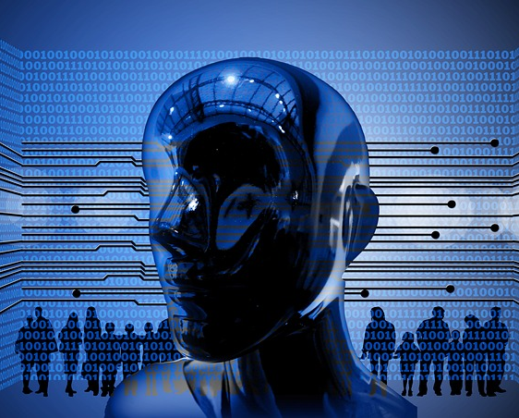
Artificial Intelligence
By: Brandon Shin
CS 131 Discrete Structures
Spring 2022

Slide 2
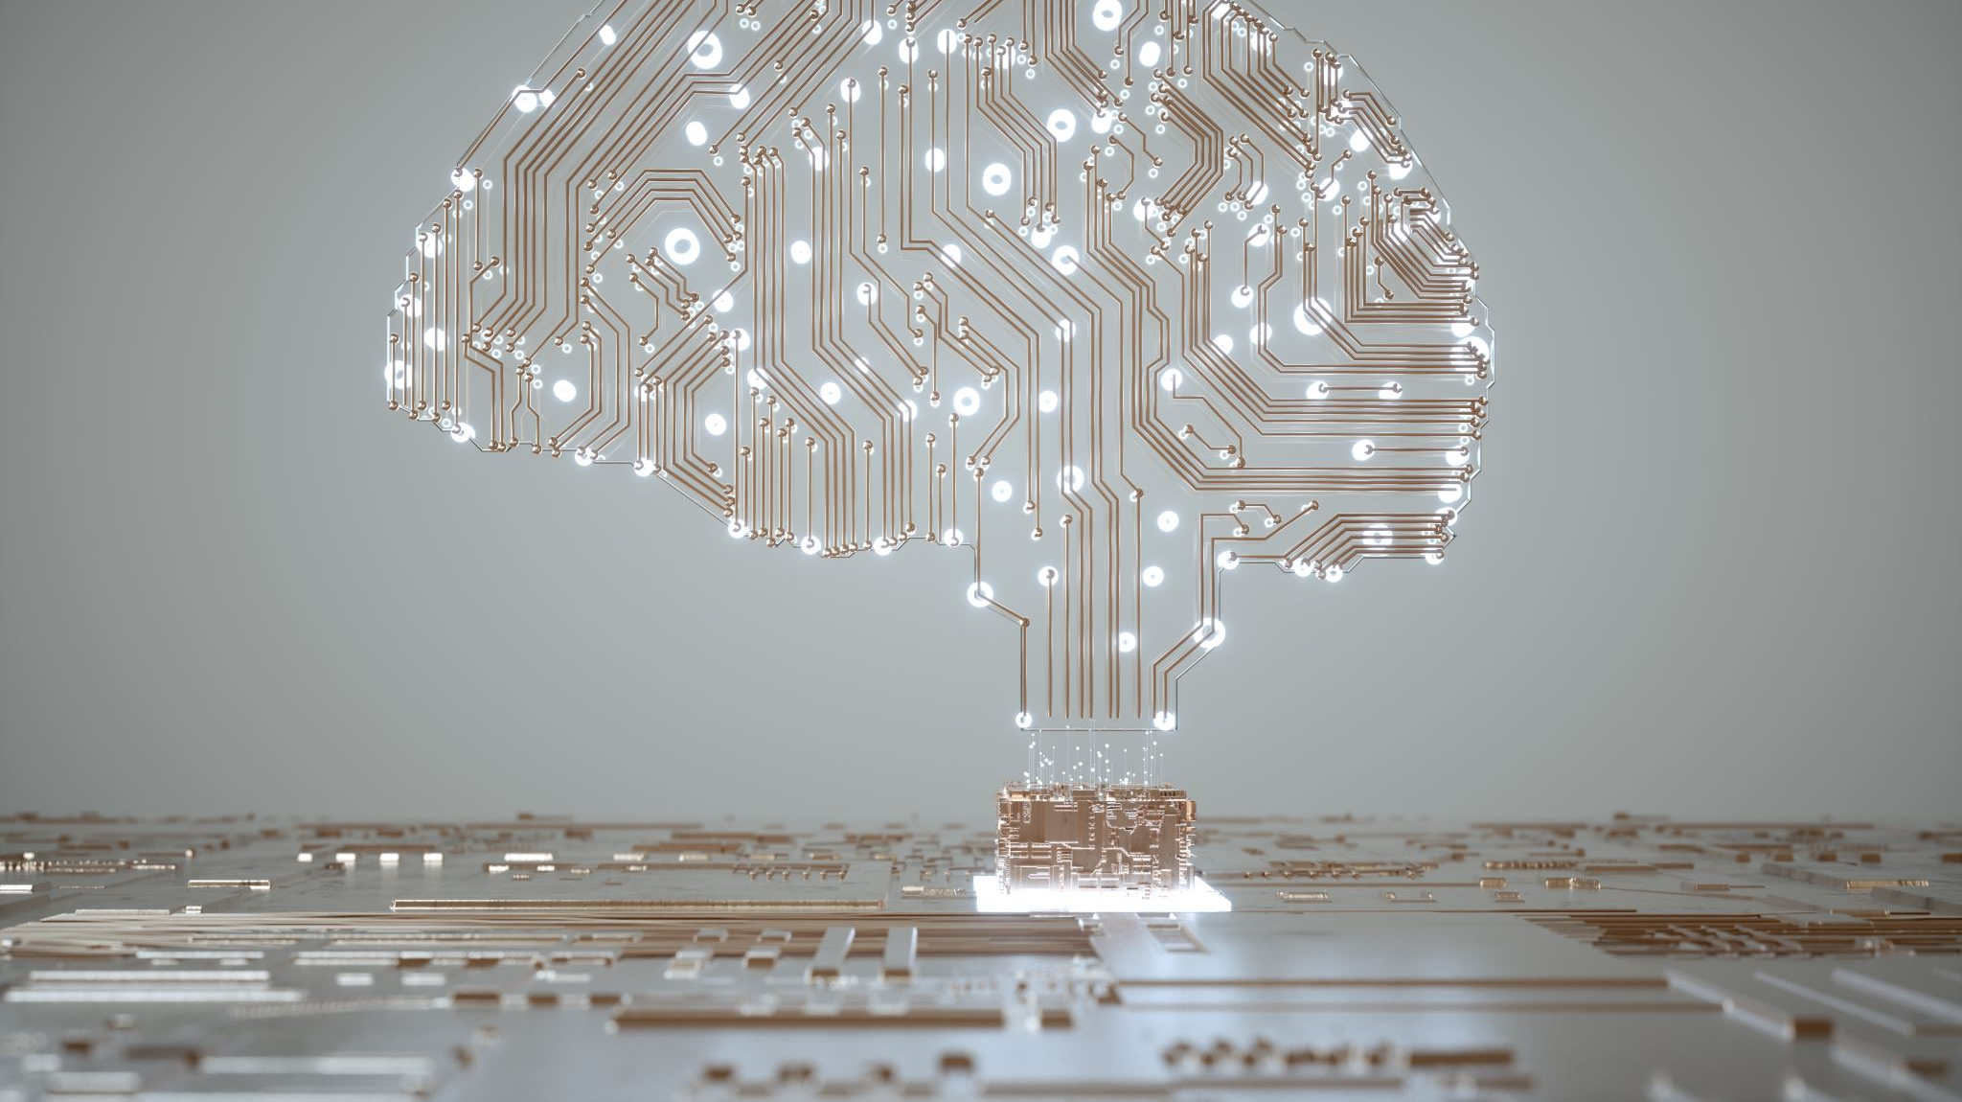
What is Artificial Intelligence?
Artificial Intelligence (AI) is a wide-ranging branch of computer science concerned with machine-driven intelligence and machine learning.
AI systems work by combining large sets of data with smart, iterative processing algorithms to learn from patterns and features in the data that they analyze.
Simply put, AI allows companies and organizations to make better and more efficient decisions, improving core business processes by increasing both the accuracy and speed of strategic decision-making processes.

Slide 3
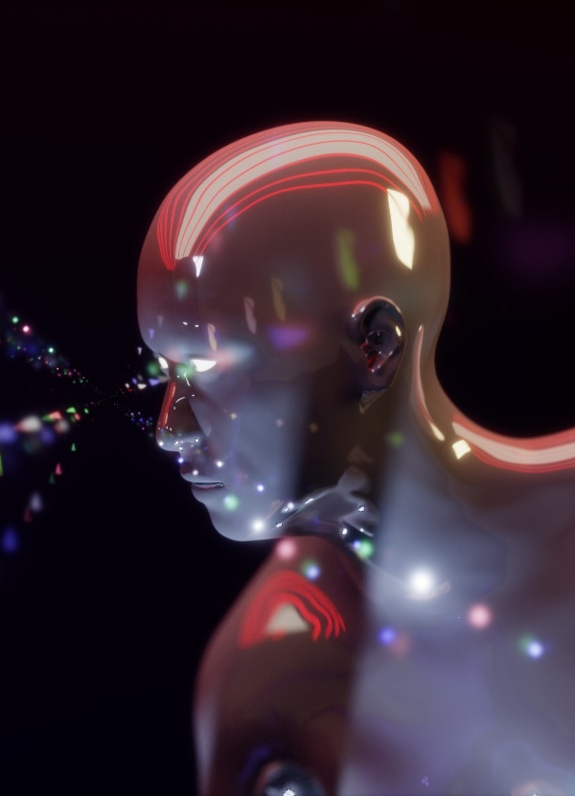
History of Artificial Intelligence (AI)
Artificial intelligence is not some new technology, this technology is much older than you would imagine.
There are many pioneers that laid the foundation of AI even as far back as Aristotle. Aristotle introduced associationism in 300 BC. But there are far more recent and notable contributions by the so-called fathers of AI.
The beginning of AI starts with John McCarthy, this is where he organized the mythic Dartmouth conference, where he first coined the term “artificial intelligence”.

Slide 4
How does AI work?
The beauty of AI is that computers are trained to accomplish specific tasks by processing large amounts of data and recognizing patterns in the data.
Artificial intelligence is so amazing because it makes it possible for machines to learn from experience, adjust to new inputs and perform human-like tasks.
For many corporations there aren’t many people to answer the phone anymore, you can use AI to guide customers instead of hiring people.
Now you can see in many businesses that AI makes business more accurate and faster. You can fire 10,000 people and replace it with a software. If you were a business owner, you can pay less people and not worry about people flaking and their pay.

Slide 5
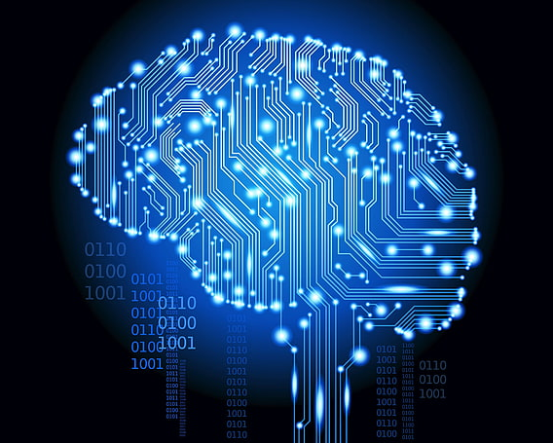
Why is AI important?
AI automates repetitive learning and discovery through data.
AI adds intelligence.
AI adapts through progressive learning algorithms.
AI analyzes more and deeper data which leads to getting more out of the data.
AI achieves incredible accuracy.

Slide 6
How is AI being Applied?
When you hear about artificial intelligence (AI), it might be easy to assume that it has nothing to do with you. People may assume that AI is only something the big tech giants are focused on, and that AI doesn’t impact your everyday life.
Here are some examples:
Healthcare- AI technology has been trained to provide personalized medicine, giving reminders about when patients need to take their medicine and suggestions for exercises they may do to recover from their injury.
Banking- AI enhances the speed, precision, and effectiveness of human efforts. In financial institutions, AI techniques are used to identify which transactions are likely to be fraudulent, adopt fast and accurate credit scoring, and automate manually intense data management tasks.
Manufacturing- Artificial Intelligence can analyze and observe loT data as it streams from connected equipment to forecast expected load and demand using recurrent networks, which is a specific type of deep learning network that is combined with sequence data.
Retail- AI provides virtual shopping capabilities that offer personalized suggestions and demonstrate purchasing options with the consumer. Things like site layout and stock management will be improved over time with AI.
Overall using AI is efficient for the customer and the seller. You don’t have to have people answering phone calls all the time you can use AI to take phone calls and funnel them down to their issue and have them sent to that certain department which is much more efficient and better for society.

Slide 7
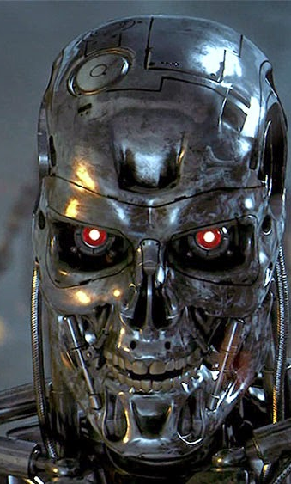

The Future of AI
Well, I really hope the future doesn’t turn into this.
This Photo by Unknown Author is licensed under CC BY-NC-ND
This Photo by Unknown Author is licensed under CC BY-NC-ND

Slide 8
The Future of AI
Artificial Intelligence has the potential to revolutionize our world, the way we do things and how we live, and you can already say that it’s already starting to do that.
AI is impacting the future of virtually every industry and every human being. We see this with companies like tesla who have cars that can drive without a human.
AI is projected to have a lasting impact on every corporation imaginable. We already see AI in cars, healthcare system, smart devices, and our favorite apps, and we’ll continue to see its impact permeate into many other industries in the future.

Slide 9
Works cited:
https://www.bbvaopenmind.com/en/technology/artificial-intelligence/the-true-father-of-artificial-intelligence/
https://builtin.com/artificial-intelligence

Slide 10
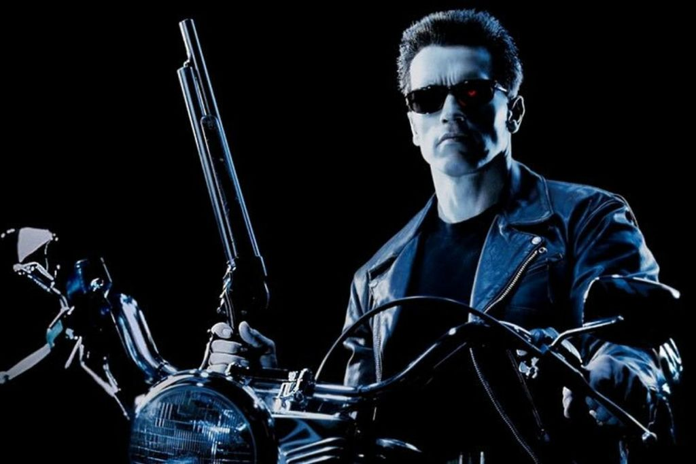
End of Presentation

